Slide 1

An Introduction to the
National Association of Healthcare Revenue Integrity

Slide 2

Presented by
Andrea Kraynak, CPC, NAHRI director
Jaclyn Fitzgerald, NAHRI associate director
Jugna Shah, MPH, NAHRI advisory board member and president, Nimitt Consulting Inc.
Diane G. Weiss, CPC, CPB, CCP, NAHRI advisory board member and vice president, reimbursement, at RestorixHealth

Slide 3
Agenda
Introduction to NAHRI and its mission
Member benefits
Brief tour of the NAHRI website, including publications, resources, and forums
Discussion with Advisory Board Members
Up and coming benefits and programs coming in 2018

Slide 4
About NAHRI
NAHRI is the nation's only association dedicated to the revenue integrity profession. Members have access to articles, helpful forms and tools, networking events, special discounts, and much more.
NAHRI’s mission is to enhance the revenue integrity profession through standards, advocacy, networking, and the promotion of shared knowledge and resources.

Slide 5
Defining revenue integrity
  The basis of revenue integrity is to prevent recurrence of issues that can cause revenue leakage and/or compliance risks through effective, efficient, replicable processes and internal controls across the continuum of patient care, supported by the appropriate documentation and the application of sound financial practices that are able to withstand audits at any point in time.

Slide 6


Membership benefits
NAHRI members receive:
Advocacy and leadership from the NAHRI Advisory Board
Bi-Weekly tips, news, and strategies in our e-newsletter, Revenue Integrity Insider
In-depth news, analysis, and regulatory information, case studies on building successful
programs, and membership profiles in our quarterly journal, the NAHRI Journal
An opportunity to network with peers and colleagues in the NAHRI Forum
Access to live and archived quarterly conference calls, hour-long networking discussions, and more
Helpful tools accessed in our electronic Resource Library, including sample queries, policies, and tools
Access to the Revenue Cycle Career Center
Discounts to the annual Revenue Integrity Symposium, certification (coming soon!), and HCPro boot camps

Slide 7
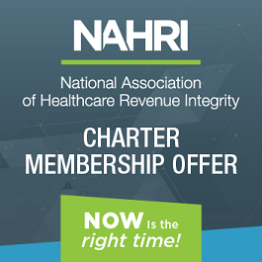

Charter Membership benefits
Save 20% by becoming a charter member!
Charter Members also receive a limited-time only welcome kit that includes:
Personalized membership card
NAHRI logo embossed journal
A complimentary copy of the Revenue Integrity Training Handbook, written by NAHRI board member Elizabeth Lamkin, MHA, ACHE
And a printed guide to your membership benefits
Become a charter member:
www.hcmarketplace.com/NAHRI or call 1-800-650-6787

Slide 8
Live website demonstration
www.nahri.org

Slide 9
Advisory Board Members
Catherine Boerner, JD, CHC, President, Boerner
Consulting, LLC
Sarah L. Goodman, MBA, CHCAF, CPC-H, CCP, FCS, President/CEO, SLG, Inc.
Ronald Hirsch, MD, FACP, CHCQM, Vice President,
R1 Physician Advisory Services
Elizabeth Lamkin, MHA, ACHE, CEO & Partner, PACE Healthcare Consulting, LLC
Kay Larsen Revenue Integrity Specialist, Glendale
Adventist Medical Center
Lisa Longo, CPC, CPC-I, Revenue Cycle Analyst,
Middlesex Hospital
Debbie Mackaman, RHIA, CPCO, CCDS, Regulatory
Specialist, HCPro
Debra May, Director Revenue Integrity, Renown Health
Terri Rinker, MT (ASCP), MHA, Revenue Cycle Director, Community Hospital Anderson
Valerie Rinkle, MPA, Regulatory Specialist, HCPro
Anna Santoro, MBA, CCS, CCS-P, RCC, System Director Revenue Integrity, CDM Hartford Healthcare
Donna Schneider, RN, MBA, CPHQ, CPC-P, CHC, CPCO, CHPC, System Revenue Compliance Officer, Yale New Haven Health
John D. Settlemyer, MBA, MHA, CPC, Associate VP Revenue Cycle, Carolinas HealthCare System
Jugna Shah, MPH, President, Nimitt Consulting, Inc.
Angela Lynne Simmons, CPA, VP, Revenue and Reimbursement, Vanderbilt University Medical Center
Diane G. Weiss, CPC, CPB, CCP, Vice President, Reimbursement, RestorixHealth
Denise Williams, RN, COC, Senior VP, Revenue Integrity Services, Revant Solutions

Slide 10
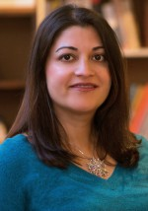
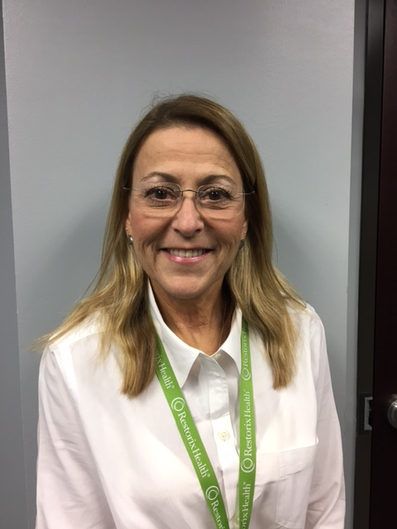
Advisory Board Member discussion
Jugna Shah, MPH, President, Nimitt Consulting Inc.
Shah is the president and founder of Nimitt Consulting, Inc., in Spicer, Minnesota, a firm specializing in provider and payer reimbursement advocacy, case-mix payment system design and implementation, and providing reimbursement and rate-setting guidance to industry as they think through market access issues. She has over 20 years of experience addressing the complex challenges of U.S. and international healthcare financing, payment, and regulatory systems. Shah helps U.S. hospitals, healthcare organizations, and industry organizations understand and address the ongoing challenges of existing and new Medicare payment systems, including the Inpatient, Outpatient, and Physician payment systems. She helps clients address their clinical operations and financial management needs as a result of her deep knowledge of prospective payment systems, bundled payment systems, and new payment system initiatives. She also conducts operational and financial impact analysis; performs coding, billing, coverage, and compliance reviews particularly in the area of medical oncology and stem cell transplant; and helps clients leverage existing technology and business intelligence solutions to create sustainable processes to achieve appropriate and compliant reimbursement. Shah also works with medical organizations, patient advocates, drug and device manufacturers to identify reimbursement strategies for personalized medicine, including gene, cellular, and CAR-T therapies. Shah is also an international authority on designing and implementing case-mix based financing systems. She has led numerous technical assistance initiatives that have resulted in several foreign governments changing their healthcare financing systems. Finally, Jugna Shah has written and/or contributed to several books and OPPS/APC articles since 2001 and is a contributing editor of HCPro’s Briefings on APCs.
Diane G. Weiss, CPC, CPB, CCP, Vice President, Reimbursement, RestorixHealth
Weiss joined RestorixHealth in Metairie, Louisiana, in June 2011, which facilitated the formation of the New Orleans office revenue cycle team. Prior to joining RestorixHealth (formerly Wound Care Specialists), Weiss managed a general surgery practice for 10 years in the Greater New Orleans area where she served as practice manager and was also the surgeons in-office medical assistant. In 1995, her career moved to the payer side. She became the provider education representative for Pinnacle Medicare Services, providing CMS Medicare Part B provider education and denial management for providers throughout Louisiana and other states within the MAC jurisdiction. For those 12 years with Medicare, Weiss conducted provider education workshops, seminars, and spoke to a variety of specialty societies, coding groups and medical manager associations. She provided information and assistance with claims submission issues, denial management and effectively communicated CMS’ annual changes regarding reimbursement and coverage for Part B Providers. She also served as Ochsner Health System’s Internal Medicare Consultant for five years before joining RestorixHealth in a full-time capacity.

Slide 11
Coming in 2018
Quarterly networking calls (January 30, 2018, at 1 p.m. Eastern)
Revenue integrity credential
NAHRI podcast
Revenue Integrity Week
Mentorship and support program
Website updates
Special reports and benchmarking information
Bylaws and ethics statements
2018 Revenue Integrity Symposium and Revenue Integrity Leadership Exchange
Public policy committee

Slide 12

Questions?
Contact akraynak@nahri.org
Become a charter member:
www.hcmarketplace.com/NAHRI or call 1-800-650-6787

